Slide 1


HELLO WORLD!

Slide 2
01
02
summary
03
04
Data science
Machine Learning
What is Data Science ?
What is Machine Learning
ML Systems
Python syntax
Different types of ML systems
Getting started with python for ML

Slide 3
Data science?
what is exactly Data science and why we need it

Slide 4




how does data science make all this happen ?
choosing a phone to buy
2 GB RAM
16 MegaPx
2500 mAh
3 GB RAM
20 MegaPx
3000 mAh
4 GB RAM
24 MegaPx
3200 mAh

Slide 5

how does data science make all this happen ?
that’s what data science is all about!
we used the data that we have about the available phones to make a decision about what phone to buy

Slide 6
but...
Use tools from coding, statistics & math to work creatively with data
Data can be too big or complex that a human being can’t interpret it by himself

Slide 7

why we need data science ?
better decision making
Should we approve or reject a customer application for a loan based on his financial statement?
Whether A or B ?

Slide 8

why we need data science ?
Predictive analysis
Can we predict delays in the case of airlines ? or can we predict the demand on a product in e-commerce
What will happen next ?

Slide 9
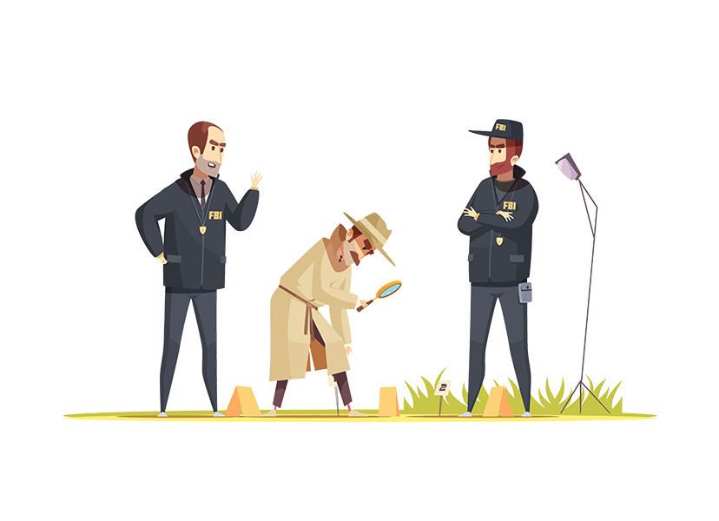
why we need data science ?
pattern discovery
what are the factors that make a certain product becomes on high demand all of a sudden ?
what are the hidden relations in the data ?

Slide 10
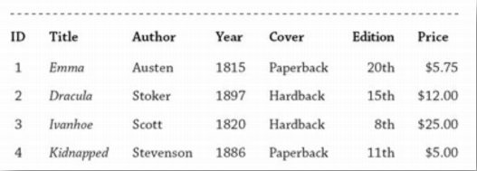
data, data, data ...
Datum Or piece of information is an abstraction of a real-world entity (person, object, or event)
The terms variable, feature, and attribute are often used interchangeably to denote an individual abstraction
Data set consists of the data relating to a collection of entities, with each entity described in terms of a set of attributes

Slide 11
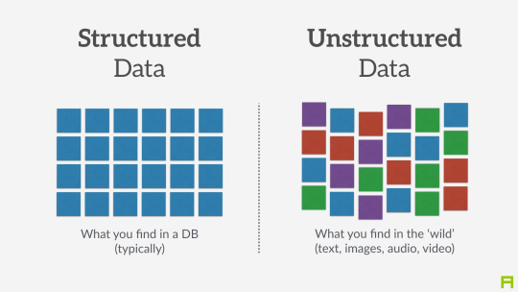
data, data, data ...
Types of Data
Structured data Can be stored in a table, and every instance in the table has the same structure (i.e., set of attributes)
Unstructured data Each instance in the data set may have its own internal structure, and this structure is not necessarily the same in every instance

Slide 12
AI? ML? DL?
Time for some terminology boys!!

Slide 13
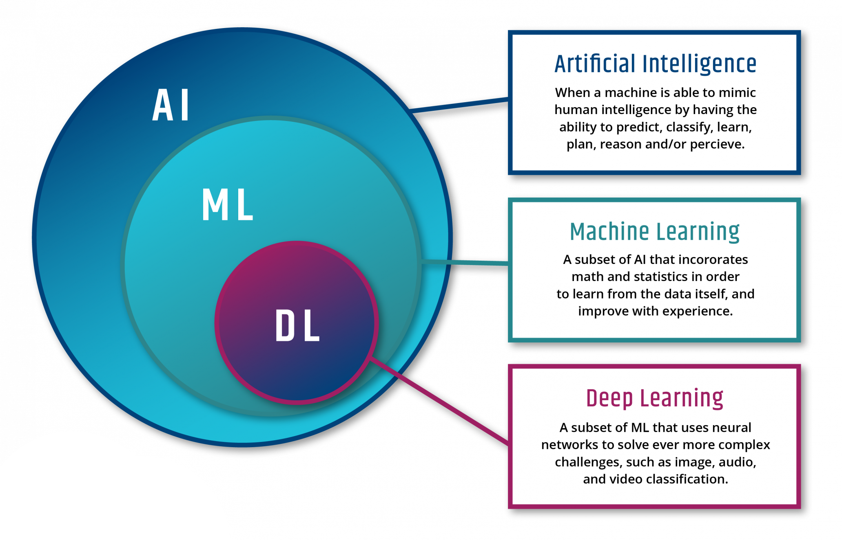
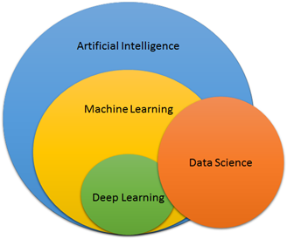
where it all fits ?

Slide 14
but...
we’re gonna have to work with Machine learning
Since we are not here to make a human-like robot...

Slide 15
Why use machine learning ?
Consider how you would write a spam filter using traditional programming
1- you would look at what spam typically looks like. You might notice that some words or phrases (such as “4U,” “credit card,” “free,” and “amazing”) tend to come up a lot in the subject. Perhaps you would also notice a few other patterns in the sender’s name, the email’s body, and so on
2- You would write a detection algorithm for each of the patterns that you noticed, and your program would flag emails as spam if a number of these patterns are detected.

Slide 16
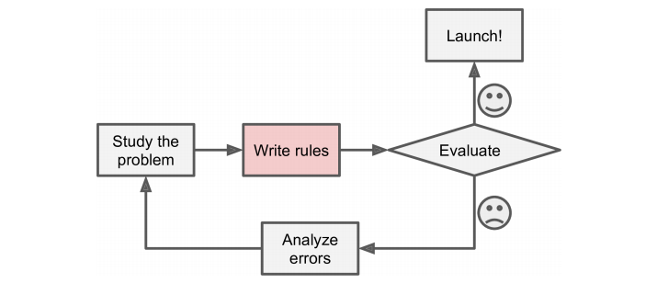
Why use machine learning ?
The traditional approach will be like …

Slide 17
Why use machine learning ?
What is the problem with this approach ?
1- if spammers notice that all their emails containing “4U” are blocked, they might start writing “For U” instead. A spam filter using traditional programming techniques would need to be updated to flag “For U” emails. If spammers keep working around your spam filter, you will need to keep writing new rules forever.
2- Since the problem is not trivial, your program will likely become a long list of complex rules pretty hard to maintain.

Slide 18
Machine learning to the rescue
A spam filter based on Machine Learning techniques automatically learns which words and phrases are good predictors of spam by detecting unusually frequent patterns of words in the spam examples compared to the ham examples
In contrast, a spam filter based on Machine Learning techniques automatically notices that “For U” has become unusually frequent in spam flagged by users, and it starts flagging them without your intervention

Slide 19
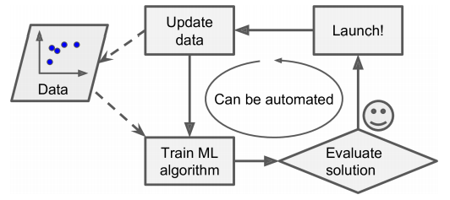
Why use machine learning ?
The Ml approach will be like …

Slide 20
What makes ML a superhero
. Problems for which existing solutions require a lot of hand-tuning or long lists of rules: one Machine Learning algorithm can often simplify code and perform better.
. Complex problems for which there is no good solution at all using a traditional approach: the best Machine Learning techniques can find a solution.
ML is the Real Deal

Slide 21
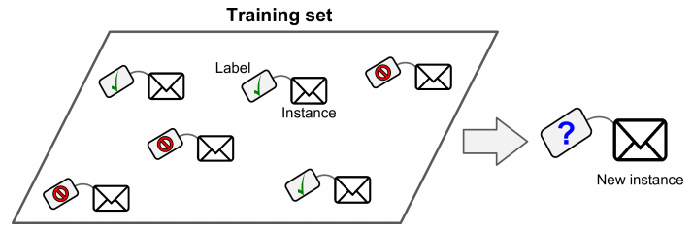
Supervised/Unsupervised Learning
Supervised learning
In supervised learning, the training data you feed to the algorithm includes the desired solutions, called labels

Slide 22

Supervised/Unsupervised Learning
EXAMPLE OF Supervised learning
A typical supervised learning task is classification. The spam filter is a good example of this: it is trained with many example emails along with their class (spam or ham), and it must learn how to classify new emails.

Slide 23
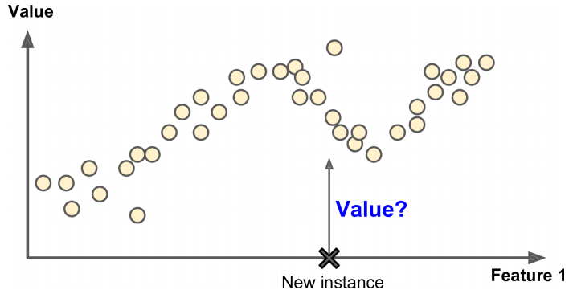
Supervised/Unsupervised Learning
Another typical task is to predict a target numeric value, such as the price of a car, given a set of features (mileage, age, brand, etc.) called predictors. This sort of task is called regression. To train the system, you need to give it many examples of cars, including both their predictors and their labels (i.e., their prices).

Slide 24
Supervised/Unsupervised Learning
most important supervised learning algorithms
• k-Nearest Neighbors
• Linear Regression
• Logistic Regression
• Support Vector Machines (SVMs)
• Decision Trees and Random Forests
• Neural networks

Slide 25
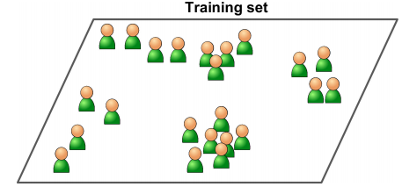
Supervised/Unsupervised Learning
UNSupervised learning
In unsupervised learning, as you might guess, the training data is unlabeled. The system tries to learn without a teacher

Slide 26
Supervised/Unsupervised Learning
most important unsupervised learning algorithms
• Clustering
— K-Means
— DBSCAN
— Hierarchical Cluster Analysis (HCA)
• Anomaly detection and novelty detection
— One-class SVM
— Isolation Forest

Slide 27
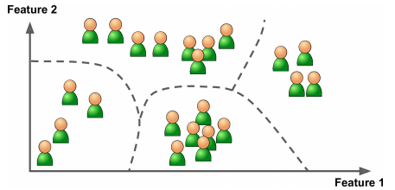
Supervised/Unsupervised Learning
EXAMPLE OF unSupervised learning (Clustering)
For example, say you have a lot of data about your blog’s visitors. You may want to run a clustering algorithm to try to detect groups of similar visitors. At no point do you tell the algorithm which group a visitor belongs to: it finds those connections without your help

Slide 28
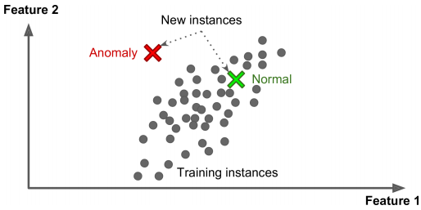
Supervised/Unsupervised Learning
EXAMPLE OF unSupervised learning (anomaly detection)
Yet another important unsupervised task is anomaly detection for example, detecting unusual credit card transactions to prevent fraud, catching manufacturing defects. The system is shown mostly normal instances during training, so it learns to recognize them and when it sees a new instance it can tell whether it looks like a normal one or whether it is likely an anomaly

Slide 29
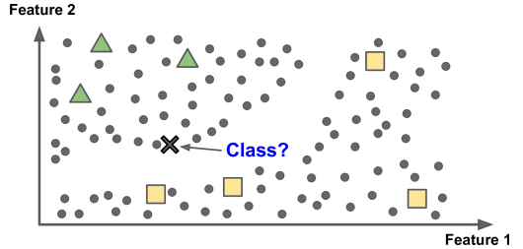
Supervised/Unsupervised Learning
semiSupervised learning
Some algorithms can deal with partially labeled training data, usually a lot of unlabeled data and a little bit of labeled data.

Slide 30
Supervised/Unsupervised Learning
EXAMPLE OF semiSupervised learning
Some photo-hosting services, such as Google Photos, are good examples of this. Once you upload all your family photos to the service, it automatically recognizes that the same person A shows up in photos 1, 5, and 11, while another person B shows up in photos 2, 5, and 7. This is the unsupervised part of the algorithm (clustering). Now all the system needs is for you to tell it who these people are. Just one label per person,4 and it is able to name everyone in every photo, which is useful for searching photos.

Slide 31
Supervised/Unsupervised Learning
reinforcement learning
The learning system, called an agent in this context, can observe the environment, select and perform actions, and get rewards in return (or penalties in the form of negative rewards. It must then learn by itself what is the best strategy, called a policy, to get the most reward over time. A policy defines what action the agent should choose when it is in a given situation.

Slide 32
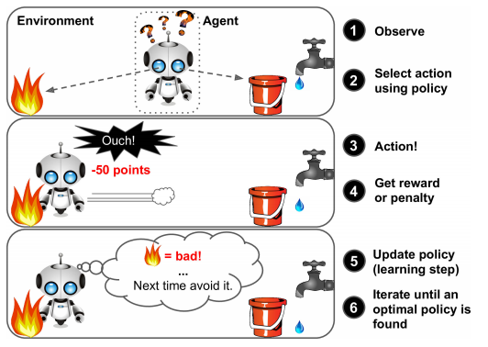
Supervised/Unsupervised Learning
EXAMPLE OF reinforcement learning

Slide 33
Batch and online Learning
batch learning
In batch learning, the system is incapable of learning incrementally: it must be trained using all the available data. This will generally take a lot of time and computing resources, so it is typically done offline. First the system is trained, and then it is launched into production and runs without learning anymore; it just applies what it has learned. This is called offline learning

Slide 34
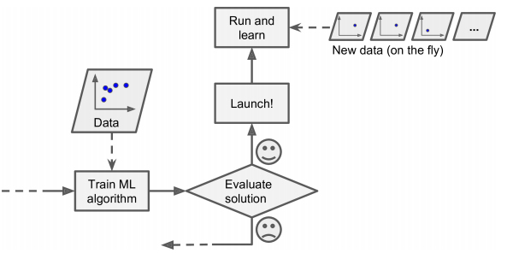
Batch and online Learning
online learning
In online learning, you train the system incrementally by feeding it data instances sequentially, either individually or by small groups called mini-batches. Each learning step is fast and cheap, so the system can learn about new data on the fly, as it arrives

Slide 35
Batch and online Learning
Pros and cons of batch learning
If you want a batch learning system to know about new data (such as a new type of spam), you need to train a new version of the system from scratch on the full dataset (not just the new data, but also the old data), then stop the old system and replace it with the new one.
Also, training on the full set of data requires a lot of computing resources (CPU, memory space, disk space, disk I/O, network I/O, etc.).

Slide 36
Batch and online Learning
Pros and cons of online learning
A big challenge with online learning is that if bad data is fed to the system, the system’s performance will gradually decline. If we are talking about a live system, your clients will notice. For example, bad data could come from a malfunctioning sensor on a robot, or from someone spamming a search engine to try to rank high in search.

Slide 37
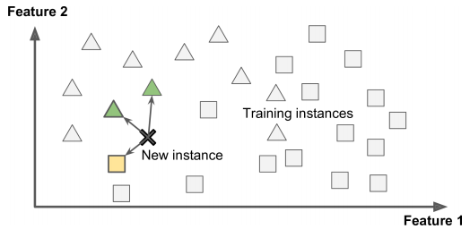
Instance-Based Versus Model-Based Learning
Instance-based learning
the system learns the examples by heart, then generalizes to new cases by comparing them to the learned examples (or a subset of them), using a similarity measure. For example, the new instance would be classified as a triangle because the majority of the most similar instances belong to that class.

Slide 38
Instance-Based Versus Model-Based Learning
Instance-based learning
Possibly the most trivial form of learning is simply to learn by heart. If you were to create a spam filter this way, it would just flag all emails that are identical to emails that have already been flagged by. Instead of just flagging emails that are identical to known spam emails, your spam filter could be programmed to also flag emails that are very similar to known spam emails. This requires a measure of similarity between two emails. A (very basic) similarity measure between two emails could be to count the number of words they have in common. The system would flag an email as spam if it has many words in common with a known spam email.

Slide 39
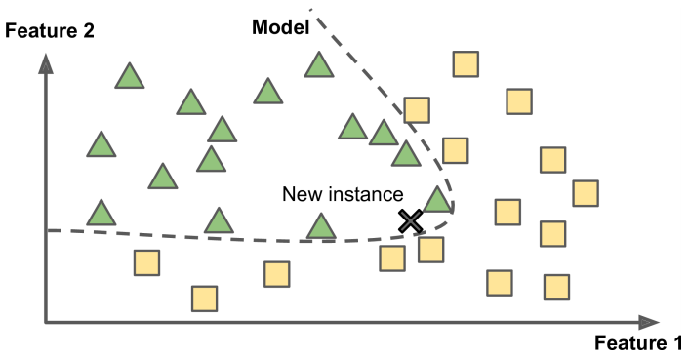
Instance-Based Versus Model-Based Learning
model-based learning
Another way to generalize from a set of examples is to build a model of these examples, then use that model to make predictions. This is called model-based learning.

Slide 40
types of machine learning Systems
• Whether or not they are trained with human supervision (supervised, unsupervised, semisupervised, and Reinforcement Learning)
• Whether or not they can learn incrementally on the fly (online versus batch learning)
• Whether they work by simply comparing new data points to known data points, or instead detect patterns in the training data and build a predictive model, much like scientists do (instance-based versus model-based learning)

Slide 41
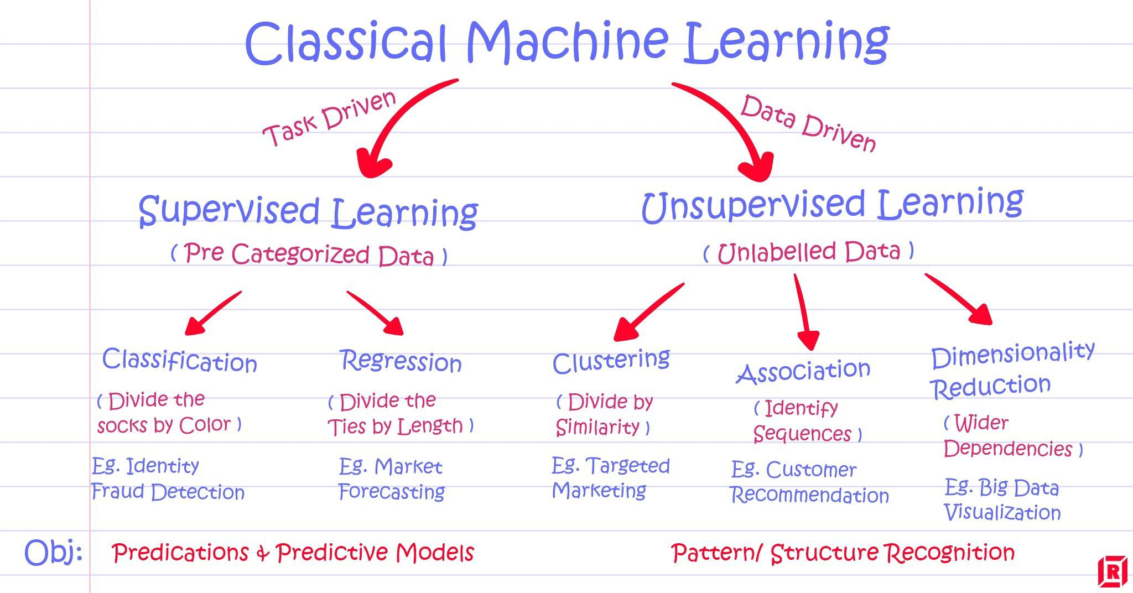
modelsethods of machine learning

Slide 42
Python for ML
Getting started with python for ML

Slide 43

Why python exactly ?
Python emphasizes code readability, and this in turn has an impact on productivity: Not only is a data scientist able to create scripts to be executed as a batch, but also is able to start an interactive console (iPython shell for instance) or notebook.
Furthermore, the Python ecosystem is supported by various packages that extend and enhance the language:

Slide 44

Python environment
The iPython/Jupyter notebook is a great way to do this. Not only does it let you run your code in the same way as the interactive shell and add comments to your code, but also enables you to document your code, calculations and processing all within a web-based interface. In this book, we have made a conscious decision not to use the iPython/Jupyter notebook for printing purposes, however I would encourage you to make use of it whenever you can.

